Slide 1
Chapter 11
Aggression

Slide 2
What Is Aggression?
Aggression
  Behavior intended to harm another individual
  Two main types
Proactive aggression
  Aggressive behavior whereby harm is inflicted as a means to a desired end (also called instrumental aggression).
Reactive aggression
  Aggressive behavior where the means and the end coincide; harm is inflicted for its own sake.

Slide 3
Origins of Aggression
Is aggression innate? Or is it learned?

Slide 4
Culture and Aggression
Cultures vary dramatically in how—and how much—their members aggress against each other.
Comparisons across societies
  Trends in violent crime rates, kinds of aggression, and who is involved
  People’s attitudes toward various kinds of aggression also differ internationally.

Slide 5
The Violent Crime Clock
In the United States in 2018, there was, on average:
One MURDER every 32.4 minutes
One RAPE every 3.8 minutes
One AGGRAVATED ASSAULT every 65.1 seconds
One VIOLENT CRIME every 43.6 seconds
Notes:
Table 11.1 The Violent Crime Clock Although the rates of violent crimes in the United States have declined in recent years, they are still distressingly high, as these averaged statistics illustrate, and are much higher than they were several decades ago.
Based on Federal Bureau of Investigation statistics

Slide 6
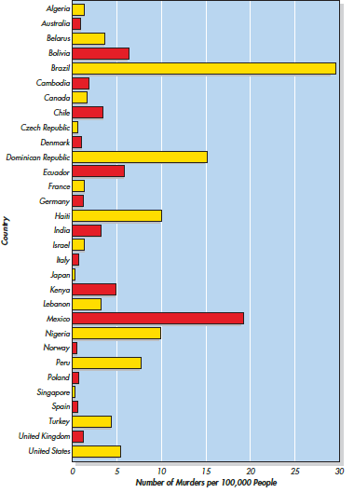
United Nations, 2019
Notes:
Figure 11.1 Murder Around the World These figures indicate the reported number of recorded intentional homicides per 100,000 people in each of several countries in 2018 or the most recent year for which statistics are available, according to United Nations statistics published in 2019. Interpret the numbers with great caution, however, because there are large differences in reporting and recording practices in the various countries, but the basic point is clear: There is wide variation in the frequency of murder around the world.

Slide 7
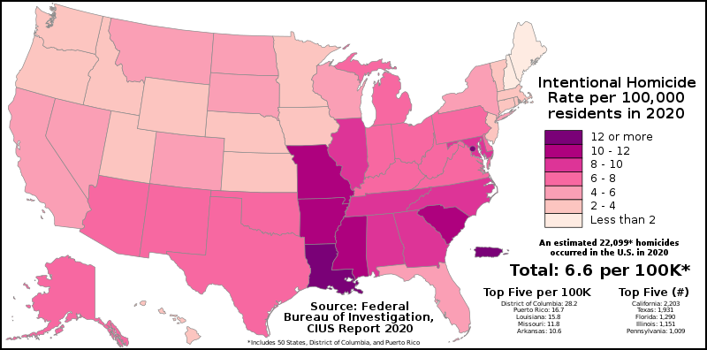
FBI 2020
Notes:
Figure 11.1 Murder Around the World These figures indicate the reported number of recorded intentional homicides per 100,000 people in each of several countries in 2018 or the most recent year for which statistics are available, according to United Nations statistics published in 2019. Interpret the numbers with great caution, however, because there are large differences in reporting and recording practices in the various countries, but the basic point is clear: There is wide variation in the frequency of murder around the world.

Slide 8
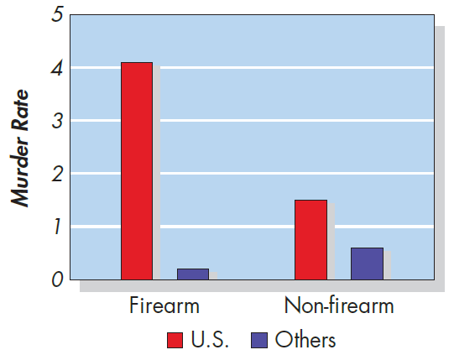
Murder Rates in High-Income Countries: With and Without Guns (Grinshteyn & Hemenway, 2019)
Notes:
Figure 11.3 Murder Rates in High-Income Countries: With and Without Guns The rate of murders—either with or without the use of firearms—per 100,000 people in the United States versus the average of the 28 other countries categorized as high income by the Organization for Economic Cooperation and Development (OECD) for which the most recent data were available. The United States stands out as extraordinarily high on the murder rate involving firearms. Based on Grinshteyn & Hemenway, 2019

Slide 9
Culture and Aggression
One form of aggression that is prevalent across virtually all cultures is bullying.
A handful of societies stand out as nonviolent exceptions

Slide 10
Subcultures Within a Country
Variations in aggression within particular societies as a function of:
  Age
  Class
  Race
  Region

Slide 11
Gender and Aggression
Despite all the variation across cultures, one thing is universal: Men are more violent than women.
  Differences are stable over time and place.
What about aggression in general as opposed to violence?
  Males were consistently more physically aggressive than females.
  Boys do not tend to be more aggressive than girls when it comes to indirect or relational aggression.

Slide 12
Individual Differences (1 of 2)
“Big five” factors: Low agreeableness, low openness, and high neuroticism are associated with aggression.
  Emotional susceptibility, Type A personality, impulsivity, and being low in agreeableness predict aggression only under conditions of provocation.
  Relationship between self-esteem and aggression may also be quite different across cultures.
  The Dark Triad: Machiavellianism, psychopathy, and narcissism
    Manipulation, lack of empathy, self-centeredness

Slide 13
Individual Differences (2 of 2)
Self-control shows a clear and consistent relationship with aggression.
  Strong self-control—can resist impulses and are able to act in ways that are consistent with their personal and societal standards for appropriate behavior.
  Poor self-control—one of the strongest predictors of crime, cyberbullying, and aggression toward strangers and romantic partners.

Slide 14
Origins of Aggression: Evolutionary Approach
What can account for the gender differences in overt aggression?
  Males were able to achieve and maintain status
  Females aggress to defend their offspring against threats by others

Slide 15
Genes, Hormones, and the Brain
Is an aggressive personality type due to genes?
  Heritability explains about a third to a half of the variation in aggression in children.
  The strength of the relationship can vary depending on the type of aggression.
Variations in monoamine oxidase A (MAOA) gene have been linked to aggressive behavior.

Slide 16
The Role of Testosterone
Are there specific biological factors that influence aggression?
  Initial confidence in a link between testosterone and aggression
  other research suggests that the association between testosterone and human aggression is weaker and less reliable than expected.
High testosterone and low cortisol is what predicts aggression
  Particularly in the context of status-seeking or dominance behaviors!

Slide 17
The Role of Serotonin
Serotonin appears to work like a braking mechanism to restrain impulsive, reactive acts of aggression.
  Low levels of serotonin in the nervous system of humans and many animals are associated with high levels of aggression.
  Boosting serotonin’s activity can dampen aggressiveness along with a range of other impulsive and socially deviant behaviors.

Slide 18
Brain and Executive Functioning
Executive functioning
  The cognitive abilities and processes that allow humans to plan or inhibit their actions.
A growing body of research finds a link between poor executive functioning and high aggression.

Slide 19
How Is Aggression Learned? (1 of 2)
Aggressive behavior is strongly affected by learning.
Aggression can be positively as well as negatively reinforced
  Positive reinforcement—when aggression produces desired outcomes
  Negative reinforcement—when aggression prevents or stops undesirable outcomes

Slide 20
How Is Aggression Learned? (2 of 2)
Punishment is most likely to decrease aggression when it
  Immediately follows the aggressive behavior
  Is strong enough to deter the aggressor
  Is consistently applied and perceived as fair and legitimate by the aggressor
Stringent conditions are seldom met, and when they are not, punishment can backfire.

Slide 21
Social Learning Theory
The theory that behavior is learned through the observation of others as well as through the direct experience of rewards and punishments
Bandura, Ross, & Ross (1961) Bobo doll study
  Consistent with the cycle of violence
  Nonaggressive models can decrease violence.

Slide 22
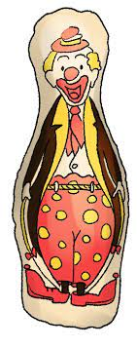
Bandura, Ross, & Ross (1961):
Bobo Doll Study
Research Question: Will children model aggressive behaviors from adults?
Design:
  Three groups: Violent actions, Non-violent, control
Predictions?

Slide 23
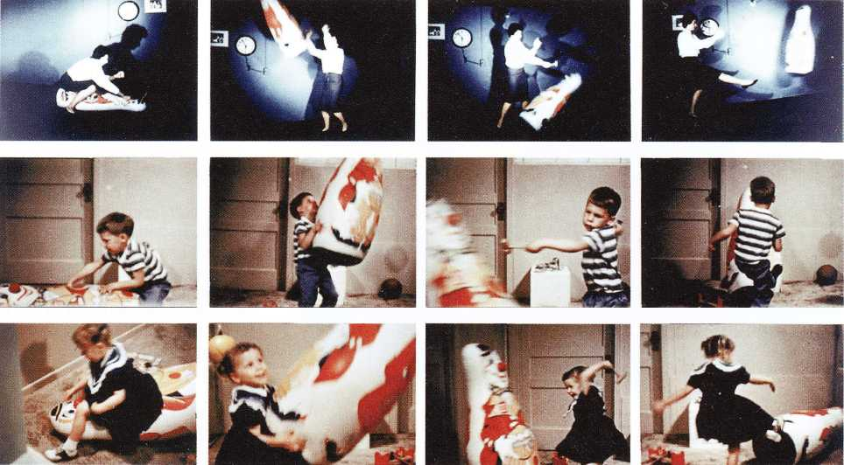
The Bobo Doll Study

Slide 24
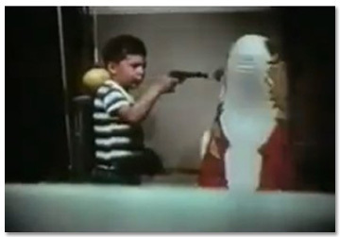
The Bobo Doll Study

Slide 25
What factors lead to aggression?
Frustration–aggression hypothesis
  The idea that frustration always elicits the motive to aggress, and that all aggression is caused by frustration
Displacement
  Aggressing against a substitute target because aggressive acts against the source of the frustration are inhibited by fear or lack of access
Catharsis
  A reduction of the motive to aggress that is said to result from any imagined, observed, or actual act of aggression

Slide 26
The Frustration–Aggression Hypothesis: Does the Evidence Support It?
Is Frustration always the root cause of aggressive behavior?
  Frustration does not always produce aggressive inclinations.
  Provoked individuals are likely to displace aggression toward others they dislike or outgroup members.
  A response incompatible with aggression, such as sympathy or humor, can be more effective.
Berkowitz: Aggression arises from general negative feelings, not just frustration.

Slide 27
Heat and Aggression
Heat and aggression
  People lose their cool in hot temperatures and behave more aggressively.
  More violent crimes occur in summer than in the winter, in hot years than in cooler years, and in hot cities than in cooler cities at any given time of year.

Slide 28
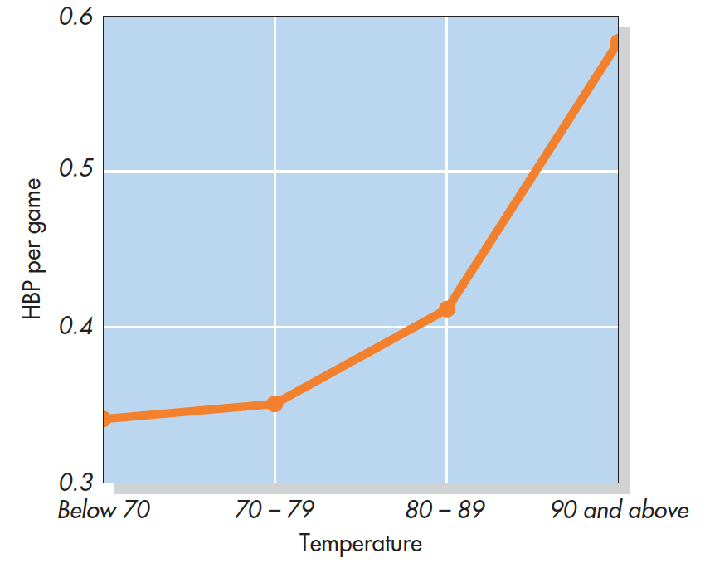
Temper and Temperature in Baseball (Reifman et al., 1991)
Notes:
Figure 11.10 Temper and Temperature in Baseball This figure shows the average number of players hit by pitches (HBP) per game during three seasons of Major League Baseball. As the temperature increased, so did the likelihood that pitchers would hit batters (with balls often thrown more than 90 miles per hour and often thrown at a batter’s head). Players’ general wildness or fatigue, as measured by walks, wild pitches, passed balls, and errors, did not increase with temperature, suggesting that the heat–HBP correlation perhaps was due to hotter temperatures that led to hotter tempers. From Reifman, Larrick, & Fein, 1991

Slide 29
Higher Order Cognition
Hostile attribution bias
  The tendency to perceive hostile intent in others
Hostile attribution bias is positively correlated with both physical and relational aggression.
Thinking about the cost of aggression can reduce aggressive behaviors
  Belief that aggression is inappropriate for the situation
  Moral values and principles mandate nonviolent behavior

Slide 30
Rumination, Alcohol, and Other Factors (1 of 2)
Rumination
  In the context of aggression, rumination involves repeatedly thinking about and reliving an anger-inducing even,
  focusing on angry thoughts and feelings, possibly centered on revenge.
High arousal makes it more difficult to engage in higher-order cognition and self-control mechanisms that can inhibit aggressive impulses.

Slide 31
Rumination, Alcohol, and Other Factors (2 of 2)
Alcohol consumption is an important risk factor in aggressive behavior.
  Lowers people’s inhibitions against aggression
  Impairs executive functioning
  Produces alcohol myopia by narrowing focus of attention, salient information rather than more subtle factors
Stimulants like caffeine can have mixed effects by boosting executive functioning but increasing arousal.

Slide 32
Situational Influences: Putting It All Together
General aggression model (GAM)
  Various aversive experiences, situational cues, and individual differences can create negative affect, high arousal, and/or aggressive thoughts, each of which contributes to aggressive behavior.
  Whether aggressive behavior is likely depends in part on the outcome of higher-order thinking.

Slide 33
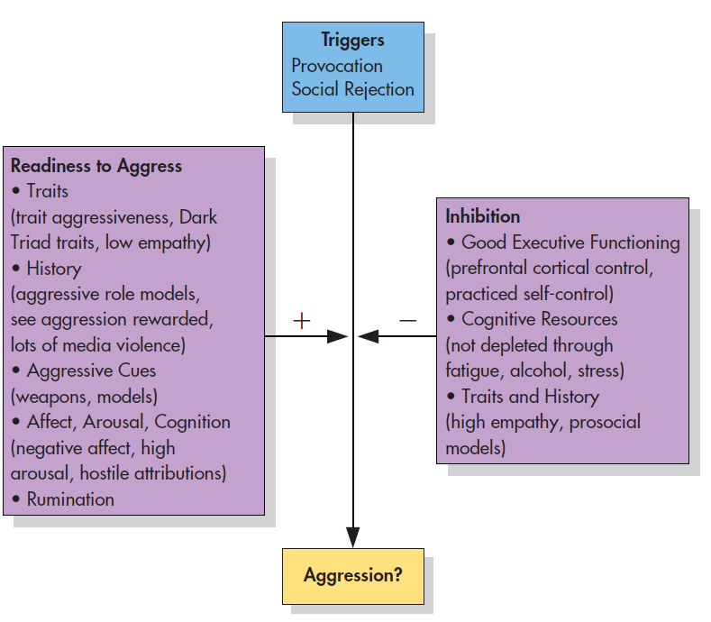
Factors Promoting and Inhibiting Reactive Aggression
Negative Event
Notes:
Figure 11.13 Factors Promoting and Inhibiting Reactive Aggression This graph pulls together a variety of the situational and individual-difference factors that we’ve discussed in this chapter to illustrate the path from a trigger of potential aggression to actual aggression. It is based in part on the General Aggression Model (e.g., Allen et al., 2018) and I3 theory (Finkel & Hall, 2018). The factors on the left (“Readiness to Aggress”) are among those that make aggression more likely. The factors on the right (“Inhibition”) make aggression less likely.

Slide 34
Media Effects
Violence depicted in the media has been a target of attack and counterattack for decades.
The amount, intensity, and graphic nature of violence have continued to escalate.
If consumers didn’t enjoy violence in TV, film, music, videos, and video games, these media outlets would not be featuring it.

Slide 35
Violence in Popular Media: Does Life Imitate Art?
Does popular media inspire violence?
  News and media reports tend to conclude that relevant scientific evidence is weak or mixed.
  Defenders of the entertainment industry consistently argue that there is no evidence that viewing media violence causes real-world aggression.

Slide 36
Research Demonstrating the Effects of Media Violence
Six major professional societies in the United States have all reached the same conclusion:
  The research evidence confirms that media violence increases the likelihood of aggressive behavior.
    Both physical and relational aggression
Media violence is neither necessary nor sufficient to cause real-world aggression and violence.

Slide 37
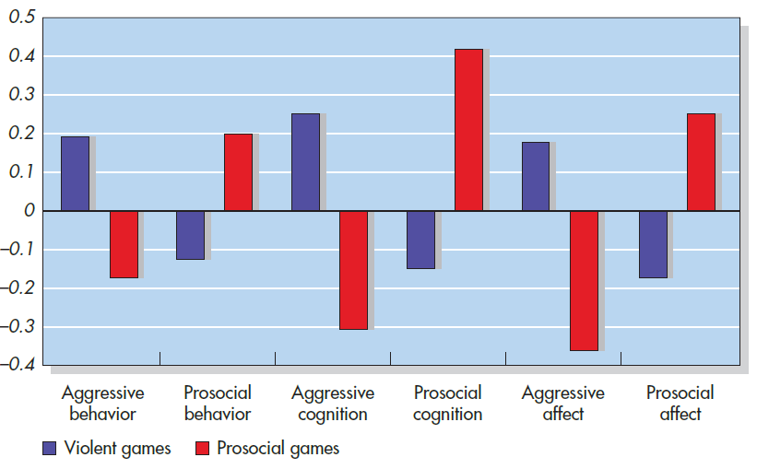
Playing Violent and Prosocial Video Games: Links With Thoughts, Feelings, and Actions
Notes:
Figure 11.14 Playing Violent and Prosocial Video Games: Links With Thoughts, Feelings, and Actions A meta-analysis of 98 studies involving about 37,000 participants in multiple countries found significant relationships between playing violent or prosocial video games and a number of outcomes. The sizes of the bars in this graph represent the magnitude of the relationships between video-game playing and these other variables; bars in a positive direction indicate a positive relationship; bars in a negative direction indicate a negative relationship. Playing violent video games (blue bars) was associated with increased aggressive behavior, cognition, and affect, and decreased prosocial behavior and affect. Playing prosocial games (red bars) had the opposite pattern. Based on Greitemeyer & Mügge, 2014

Slide 38
Thoughts, Feelings, and Self-Control
Enhanced education, intelligence, and reasoning helped cause the decline in violence over the past several centuries.
  Empathy
  Poor self-control
  Cognitive reappraisal
  Cognitive control
  Mindfulness

Slide 39
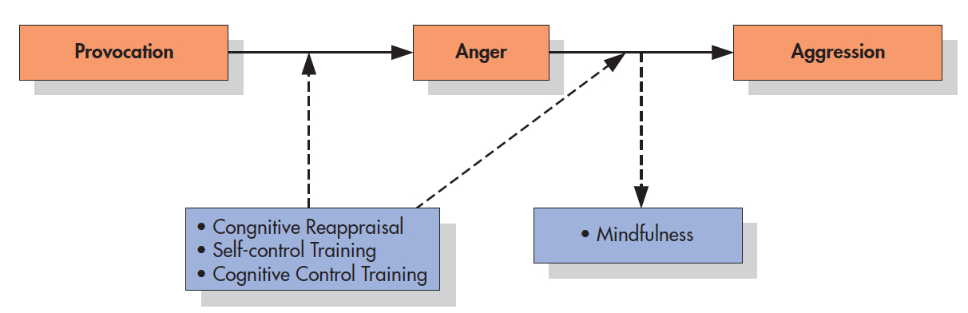
Reducing Aggression: Four Interventions
Notes:
Figure 11.17 Reducing Aggression: Four Interventions The orange boxes illustrate a typical path toward reactive aggression. The blue boxes indicate the points at which each of four interventions can block this path and thereby reduce aggression, according to Thomas Denson (2015). Based on Denson, 2015

Slide 40
Programs to Prevent Violence and Bullying
Sociocultural Approaches: An improved economy, healthier living conditions, and social support would each reduce the frustration, negative affect and thinking, and provocations that fuel much aggression.
Multiple-Level Approaches: The most effective strategies for reducing aggression recognize this complexity and work on multiple levels.

Slide 41
Multisystemic Therapy (MST)
One of the most successful treatment programs for violent juvenile delinquents.
Addresses individuals’ problems at several different levels, including the needs of the adolescents and the many contexts in which they are embedded
  Example: Anger management + addressing underlying issues

